Slide 1


Shell Scripting & Logs- Debugging Techniques
Presented by
Imran Mohammed on 17-02-2023

Slide 2

Agenda
1)Why debugging is important?
2)How to Debug shell script in Linux
3) Debugging Already Running Scripts
4)How to View Linux Logs
5) Tasks
MotivityLabs © Copyright 2021. All Rights Reserved.

Slide 3
Why debugging is important?
If things don’t go according to plan
To find bugs, analyze, and fix them
MotivityLabs © Copyright 2021. All Rights Reserved.

Slide 4
How to Debug shell Scripts
Echo
Using bash options (-n, -v,-x, -U, -O)
Using set -x inside script for the specific script
MotivityLabs © Copyright 2021. All Rights Reserved.

Slide 5


ECHO
MotivityLabs © Copyright 2021. All Rights Reserved.

Slide 6
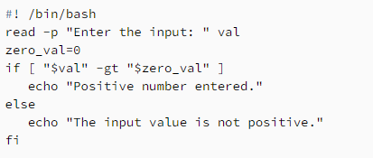
No exec (-n)
MotivityLabs © Copyright 2021. All Rights Reserved.

Slide 7
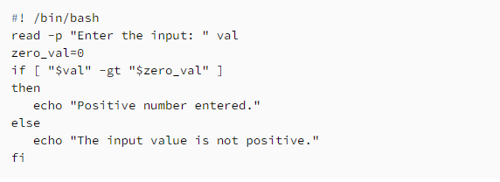
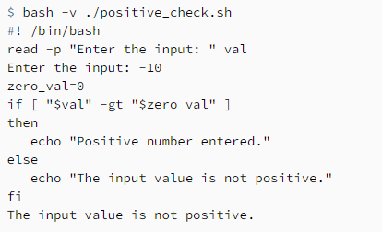
Verbose (-v)
MotivityLabs © Copyright 2021. All Rights Reserved.

Slide 8
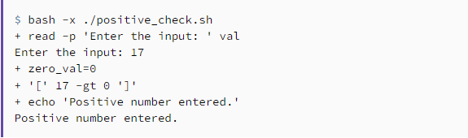
Xtrace (-x)
MotivityLabs © Copyright 2021. All Rights Reserved.

Slide 9
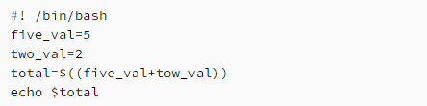
Unset variables(-u)
MotivityLabs © Copyright 2021. All Rights Reserved.

Slide 10
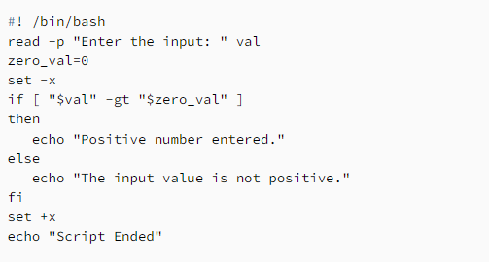
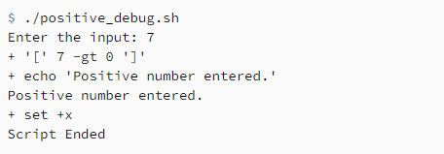
Debugging Specific Parts of the Script
MotivityLabs © Copyright 2021. All Rights Reserved.

Slide 11
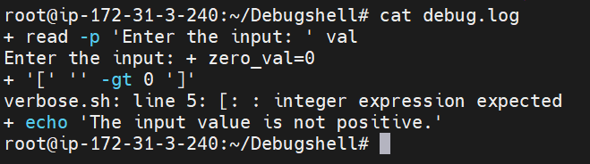
Redirecting only the Debug Output
#! /bin/bash
exec 5> debug.log
read -p "Enter the input: " val
zero_val=0
if [ "$val" -gt "$zero_val" ]
then
echo "Positive number entered."
else
echo "The input value is not positive."
fi
MotivityLabs © Copyright 2021. All Rights Reserved.

Slide 12
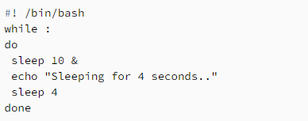
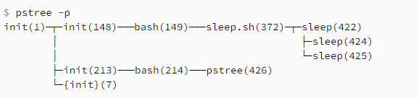
Debugging Already Running Scripts
pstree command, we can check the child processes forked by our script
MotivityLabs © Copyright 2021. All Rights Reserved.

Slide 13
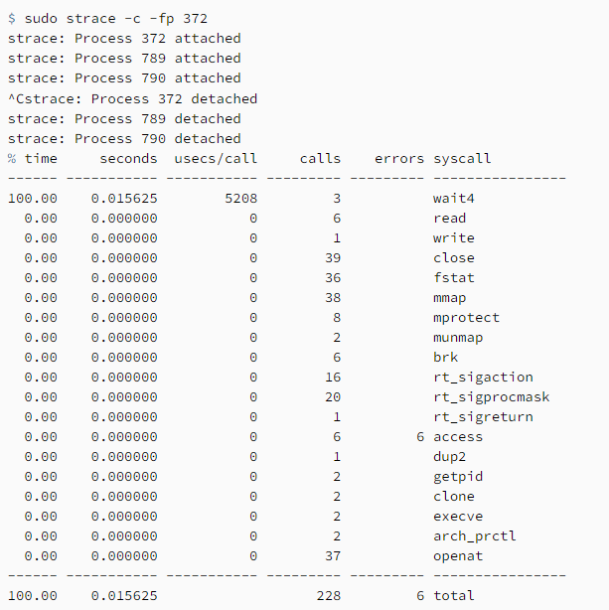
Debugging Already Running Scripts
strace command to trace the Linux system calls in progress
-p to print the process ids
f option to attach to all its child processes
-c option to print a summary of the system calls
MotivityLabs © Copyright 2021. All Rights Reserved.

Slide 14
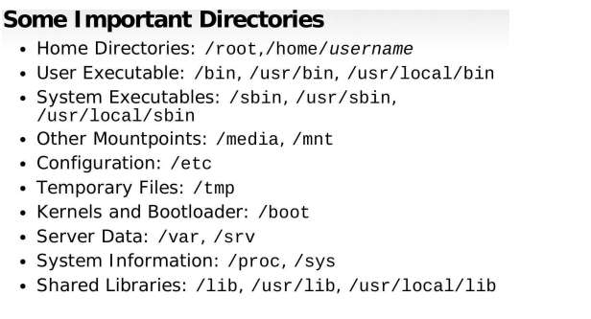
Important Directories
MotivityLabs © Copyright 2021. All Rights Reserved.

Slide 15
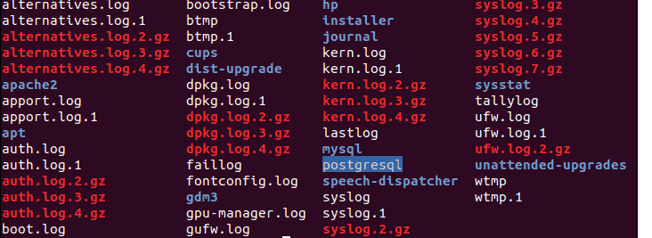
Linux Logs
zcat – Displays all the contents of logfile.gz
zmore – See the file in pages, without decompressing the files
zgrep – Search inside a compressed file
grep – Find all occurrences of a search term in a file or filter a log file
tail – Output the last few lines of files
head– View the very beginning of text files
MotivityLabs © Copyright 2021. All Rights Reserved.

Slide 16
Tasks
Task : 22 Scripts to Resolve
Location :https://github.com/DevopsImrans/Debug-Scripts
Task : Take the Backup of Kern.log and inspect the logs and Derive the Data , document the Explaination
Task : Take the Backup of Auth.log and inspect the logs and Derive the Data , document the Explaination
MotivityLabs © Copyright 2021. All Rights Reserved.

Slide 17
Thank You
MotivityLabs © Copyright 2021. All Rights Reserved.

